Slide 1
Data Mining
Ensemble Techniques
Introduction to Data Mining, 2nd Edition
by
Tan, Steinbach, Karpatne, Kumar
Introduction to Data Mining, 2nd Edition
Tan, Steinbach, Karpatne, Kumar

Slide 2
Ensemble Methods
Construct a set of classifiers from the training data
Predict class label of test records by combining the predictions made by multiple classifiers
Introduction to Data Mining, 2nd Edition
Tan, Steinbach, Karpatne, Kumar

Slide 3
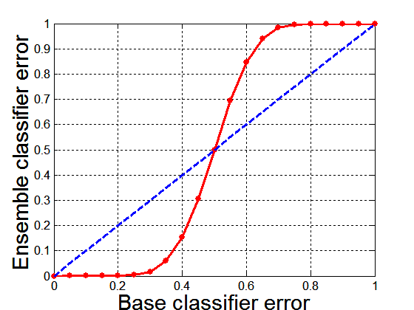
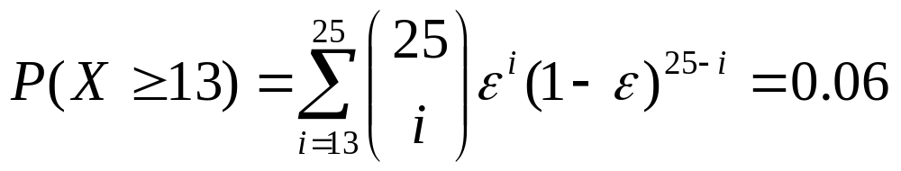
Why Ensemble Methods work?
Suppose there are 25 base classifiers
  Each classifier has
  error rate, ε = 0.35
  Assume errors made
  by classifiers are uncorrelated
  Probability that the ensemble classifier makes a wrong prediction:
Introduction to Data Mining, 2nd Edition
Tan, Steinbach, Karpatne, Kumar

Slide 4
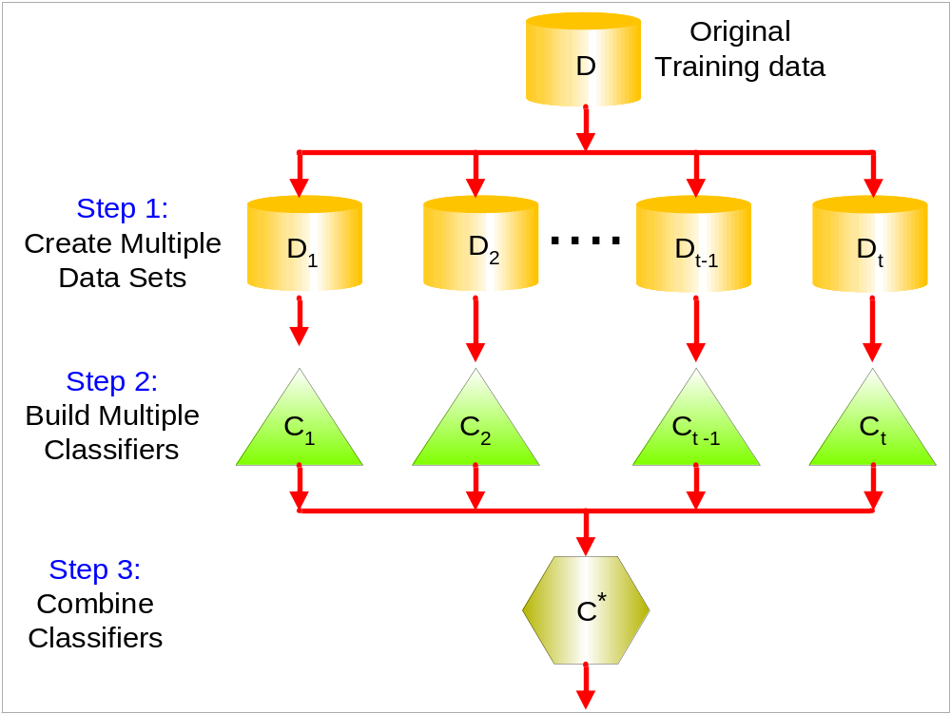
General Approach
Introduction to Data Mining, 2nd Edition
Tan, Steinbach, Karpatne, Kumar

Slide 5
Types of Ensemble Methods
Manipulate data distribution
  Example: bagging, boosting
Manipulate input features
  Example: random forests
Manipulate class labels
  Example: error-correcting output coding
Introduction to Data Mining, 2nd Edition
Tan, Steinbach, Karpatne, Kumar

Slide 6
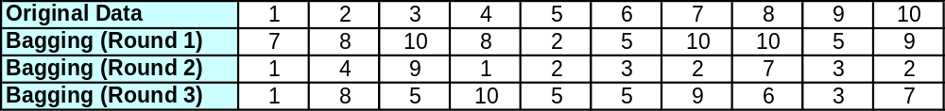
Bagging
Sampling with replacement
Build classifier on each bootstrap sample
Each sample has probability (1 – 1/n)^{n} of being selected
Introduction to Data Mining, 2nd Edition
Tan, Steinbach, Karpatne, Kumar

Slide 7
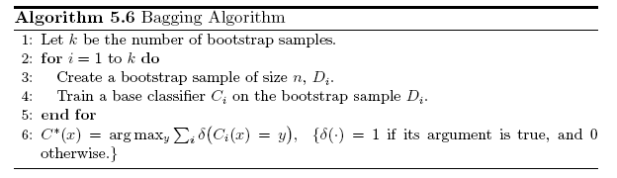
Bagging Algorithm
Introduction to Data Mining, 2nd Edition
Tan, Steinbach, Karpatne, Kumar

Slide 8
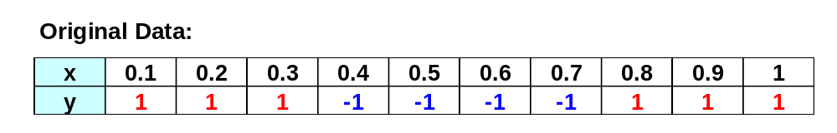
Bagging Example
Consider 1-dimensional data set:
Classifier is a decision stump
  Decision rule: x ≤ k versus x > k
  Split point k is chosen based on entropy
x ≤ k
True
False
y_{left}
y_{right}
Introduction to Data Mining, 2nd Edition
Tan, Steinbach, Karpatne, Kumar

Slide 9
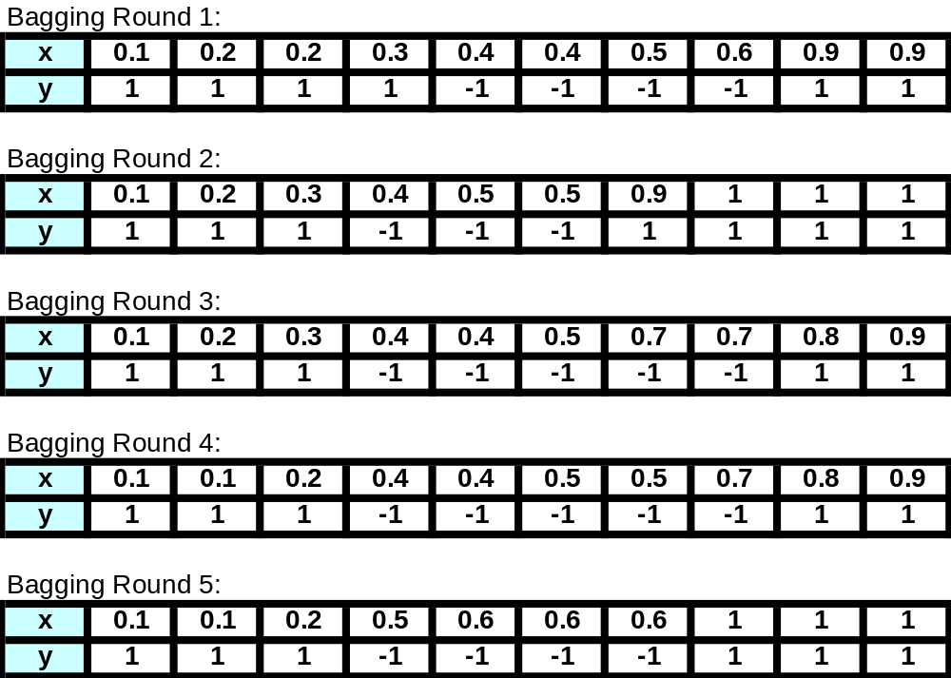
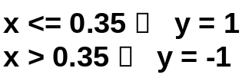
Bagging Example
Introduction to Data Mining, 2nd Edition
Tan, Steinbach, Karpatne, Kumar

Slide 10
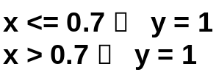
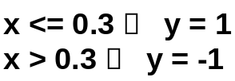
Bagging Example
Introduction to Data Mining, 2nd Edition
Tan, Steinbach, Karpatne, Kumar

Slide 11
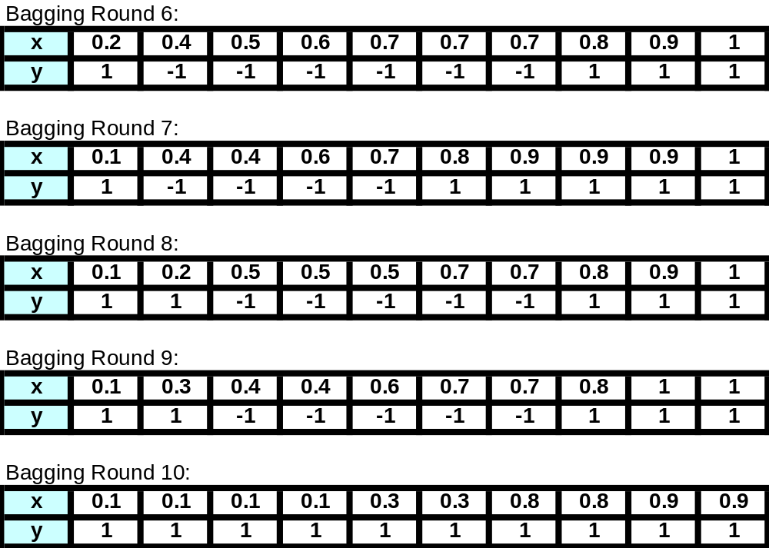
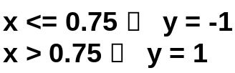
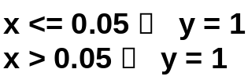
Bagging Example
Introduction to Data Mining, 2nd Edition
Tan, Steinbach, Karpatne, Kumar

Slide 12
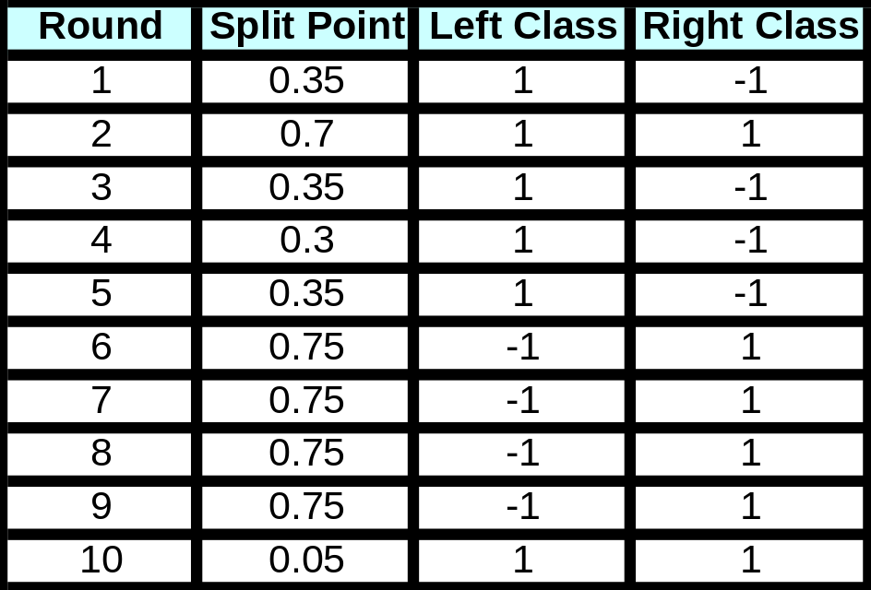
Bagging Example
Summary of Training sets:
Introduction to Data Mining, 2nd Edition
Tan, Steinbach, Karpatne, Kumar

Slide 13
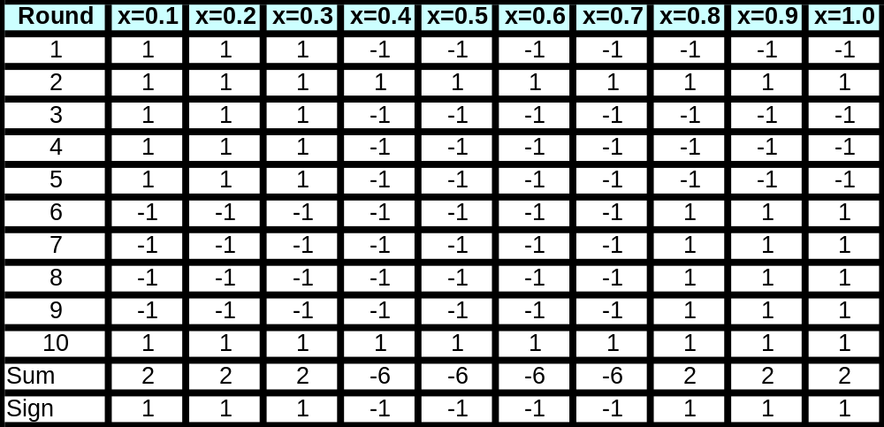
Bagging Example
Assume test set is the same as the original data
Use majority vote to determine class of ensemble classifier
Predicted Class
Introduction to Data Mining, 2nd Edition
Tan, Steinbach, Karpatne, Kumar

Slide 14
Boosting
An iterative procedure to adaptively change distribution of training data by focusing more on previously misclassified records
  Initially, all N records are assigned equal weights
  Unlike bagging, weights may change at the end of each boosting round
Introduction to Data Mining, 2nd Edition
Tan, Steinbach, Karpatne, Kumar

Slide 15
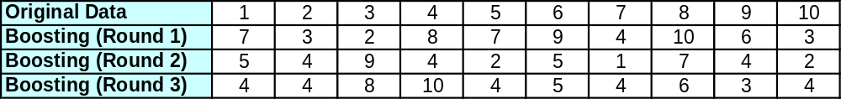
Boosting
Records that are wrongly classified will have their weights increased
Records that are classified correctly will have their weights decreased
Example 4 is hard to classify
Its weight is increased, therefore it is more likely to be chosen again in subsequent rounds
Introduction to Data Mining, 2nd Edition
Tan, Steinbach, Karpatne, Kumar

Slide 16
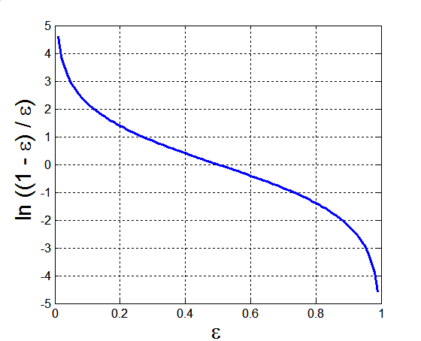
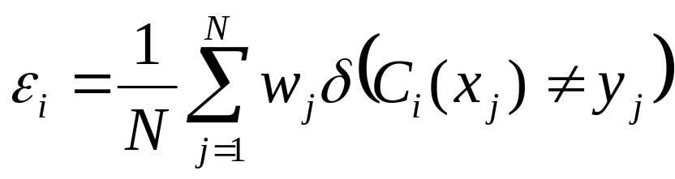
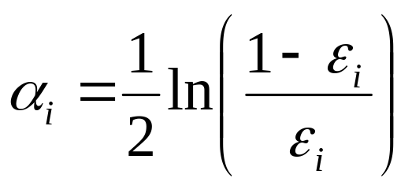
AdaBoost
Base classifiers: C₁, C₂, …, C_{T}
Error rate:
Importance of a classifier:
Introduction to Data Mining, 2nd Edition
Tan, Steinbach, Karpatne, Kumar

Slide 17
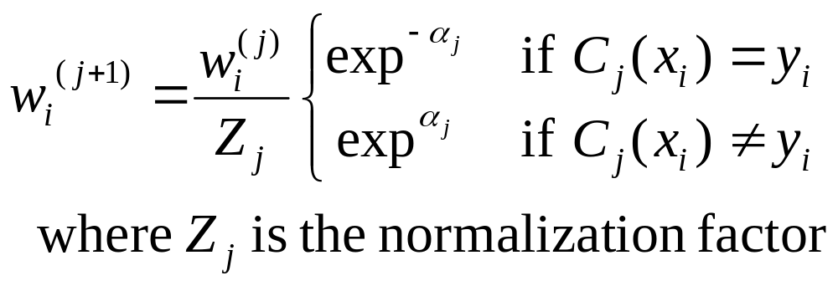
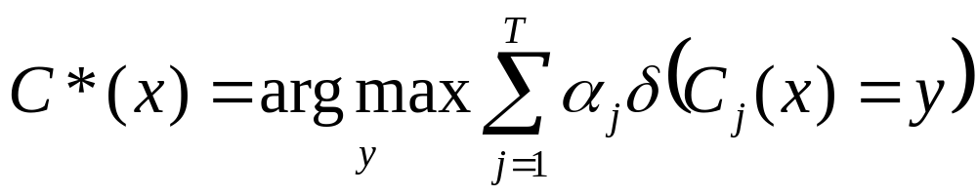
AdaBoost Algorithm
Weight update:
If any intermediate rounds produce error rate higher than 50%, the weights are reverted back to 1/n and the resampling procedure is repeated
Classification:
Introduction to Data Mining, 2nd Edition
Tan, Steinbach, Karpatne, Kumar

Slide 18
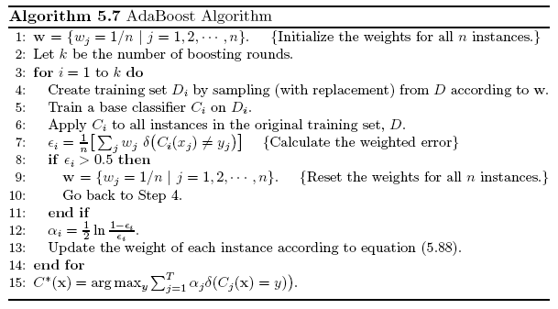
AdaBoost Algorithm
Introduction to Data Mining, 2nd Edition
Tan, Steinbach, Karpatne, Kumar

Slide 19
AdaBoost Example
Consider 1-dimensional data set:
Classifier is a decision stump
  Decision rule: x ≤ k versus x > k
  Split point k is chosen based on entropy
x ≤ k
True
False
y_{left}
y_{right}
Introduction to Data Mining, 2nd Edition
Tan, Steinbach, Karpatne, Kumar

Slide 20
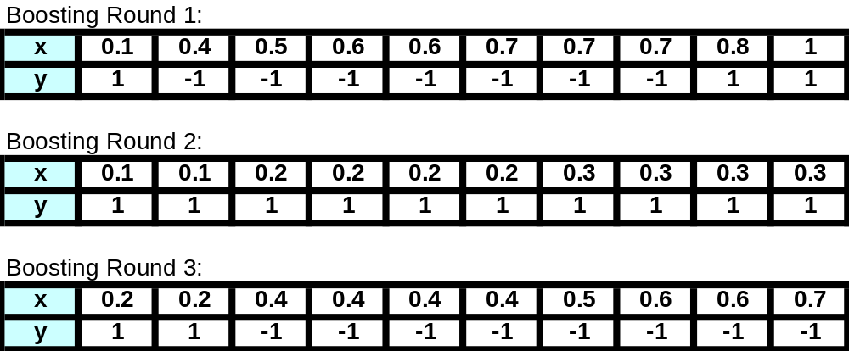
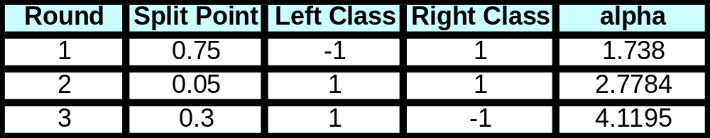
AdaBoost Example
Training sets for the first 3 boosting rounds:
Summary:
Introduction to Data Mining, 2nd Edition
Tan, Steinbach, Karpatne, Kumar

Slide 21
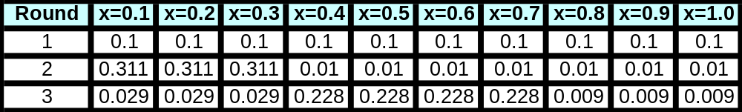
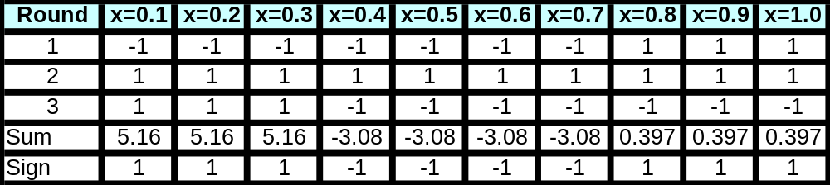
AdaBoost Example
Weights
Classification
Predicted Class
Introduction to Data Mining, 2nd Edition
Tan, Steinbach, Karpatne, Kumar

